Slide 1


Designed & Implemented by
Elizabeth Murphy 40290233
Rebekah Minnis 40301191
Dean Logan 40294254
Adam Logan 40293585
Conor Nugent 40296257

Slide 2
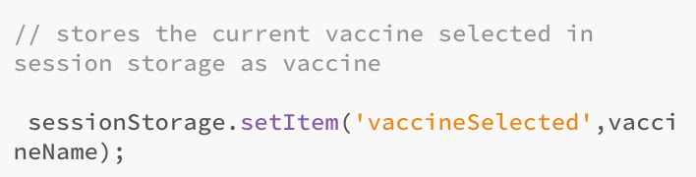
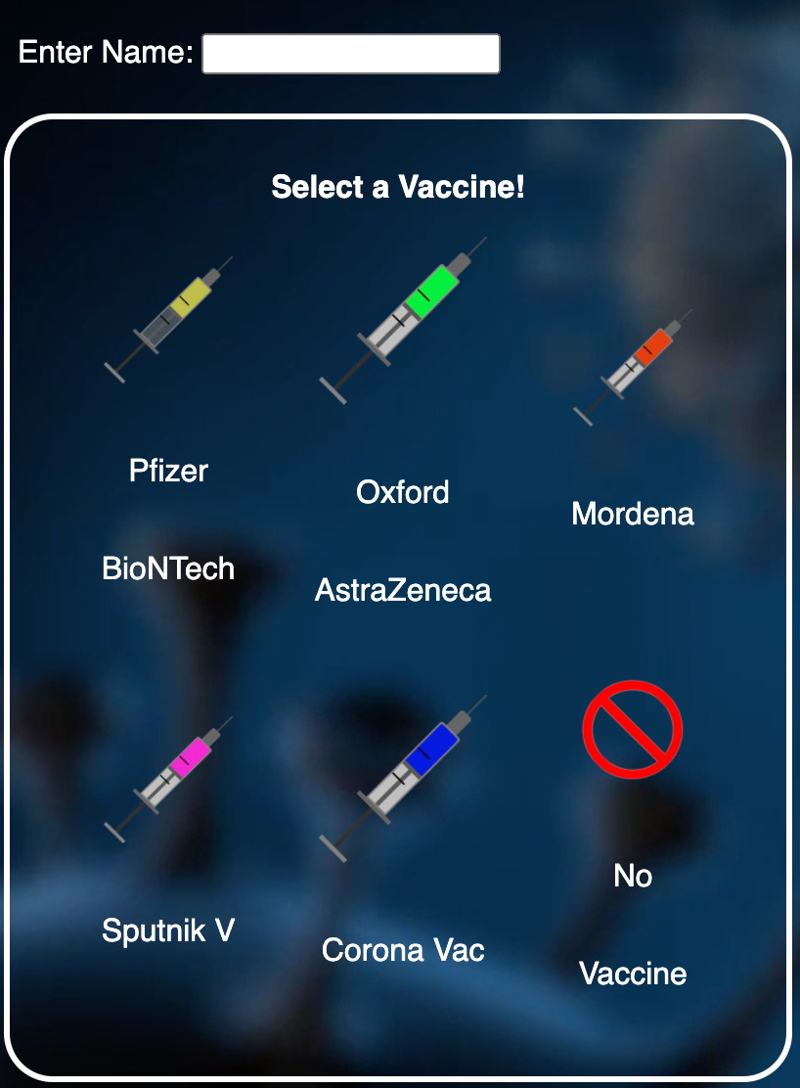
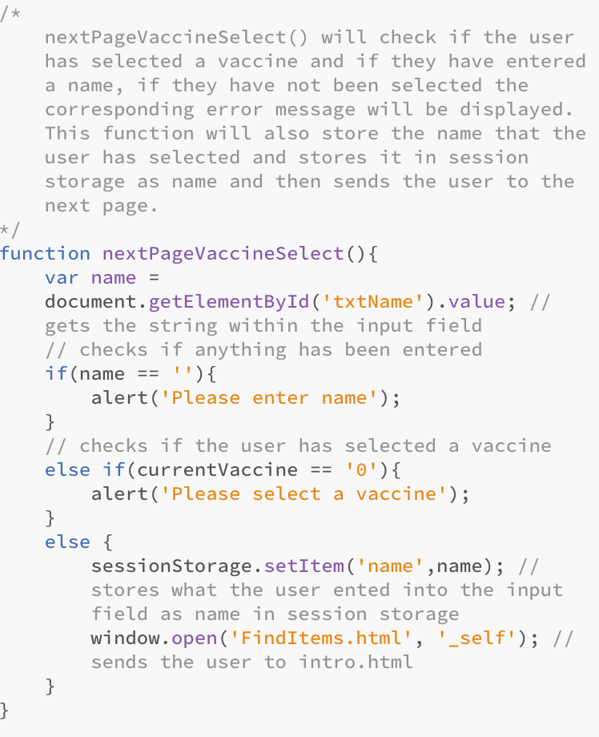
Data Collection
User selects vaccine for each game, and this will be stored in session storage
Collect users name at start of COV!D CR!S!S escape room and store it in session storage to be used for personalization of story throughout the game and to store the name associated with the time in the leaderboard

Slide 3
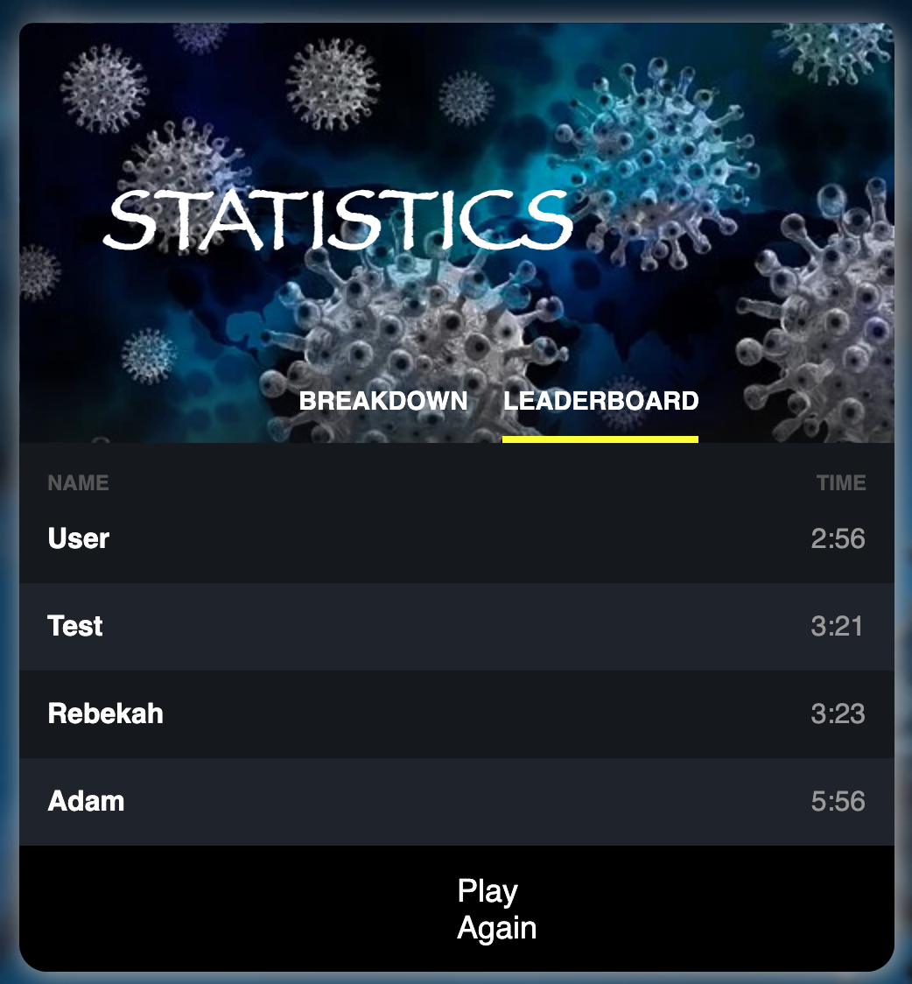
Data Collection
User can navigate from breakdown and leaderboard using the tags at the top
Leaderboard Breakdown
The Leaderboard collects overall time taken data from each player, stores as local storage and ranks them 1 to 4
Name of user ranked 1 to 4 according to fastest time (s)
Room names and time taken for user in that game session
The Breakdown collects data on the time taken (seconds) in each room by that individual player as these times have been stored in session storage throughout the game
User can press this button and escape room again

Slide 4


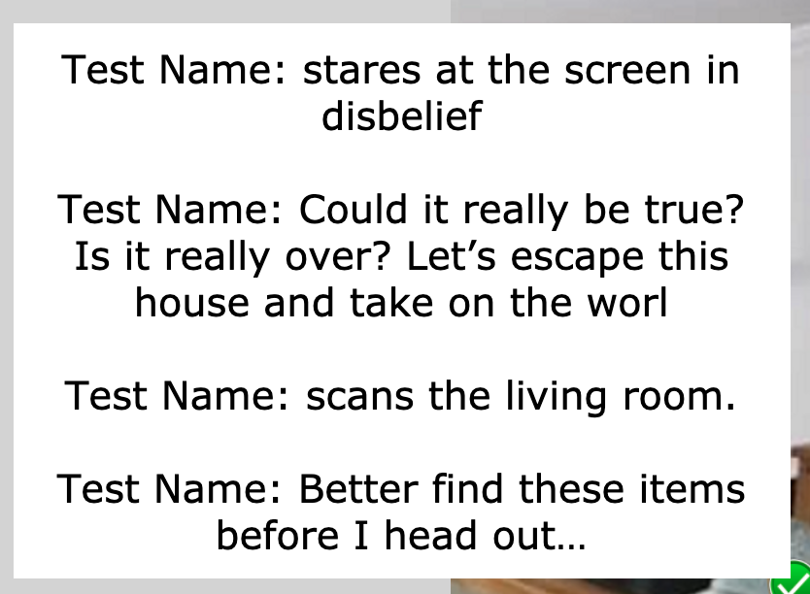
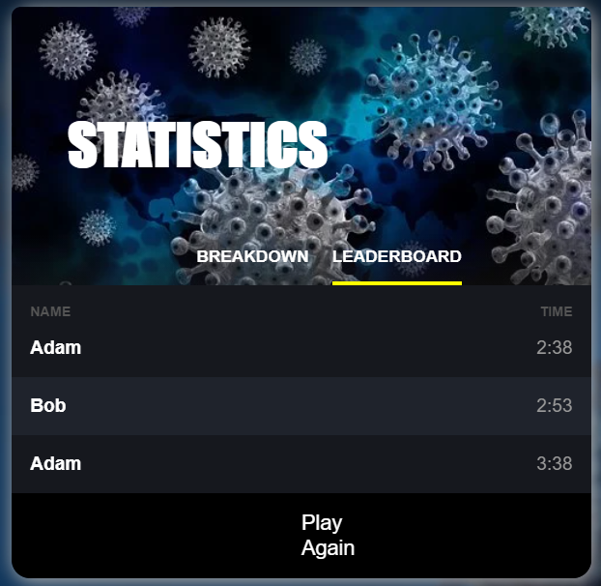
Game Personalization
User asked to enter their name
The users name that was entered on the start screen of COV!D CR!S!S is then displayed in all pages that have a story or any instructions displayed. Here is an example from the find items page
NAME PERSONALIZATION:
To ensure the users gains a personalized experience whilst playing COV!D CR!S!S we ask the user to enter their name and use it when displaying:
Story
Instructions
Leaderboard Statistics
d
Once the user completes the escape room the leaderboard is displayed, the users name is displayed in the leaderboard if they have reached the top 4 rank otherwise their name will not be displayed in the leaderboard

Slide 5


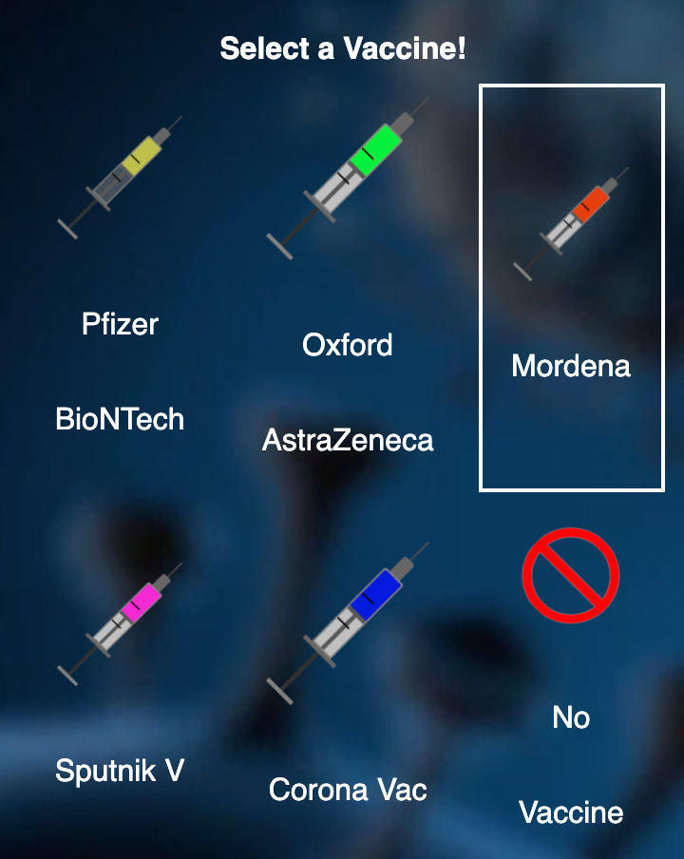





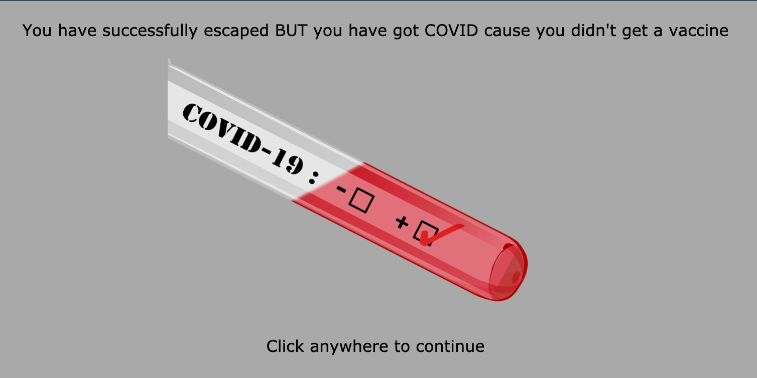
Game Personalization
Pfizer Selected
Oxford Selected
User Selects Vaccine
Vaccine personalization:
Once the user is asked for their name they are given the option to choose a vaccine (Pfizer, Oxford, Moderna, Spuntik V, Corona Vac) or choose no vaccine. The vaccine the user chooses will change some options in the game such as the vaccine the user chooses will determine what pointless items they must find. Furthermore, if the user selects no vaccine at the end of the game the user will be tole that they have tested positive for Covid even if they successfully complete the game
Moderna Selected
Sputnik V Selected
Corona Vac selected
No Vaccine selected

Slide 6

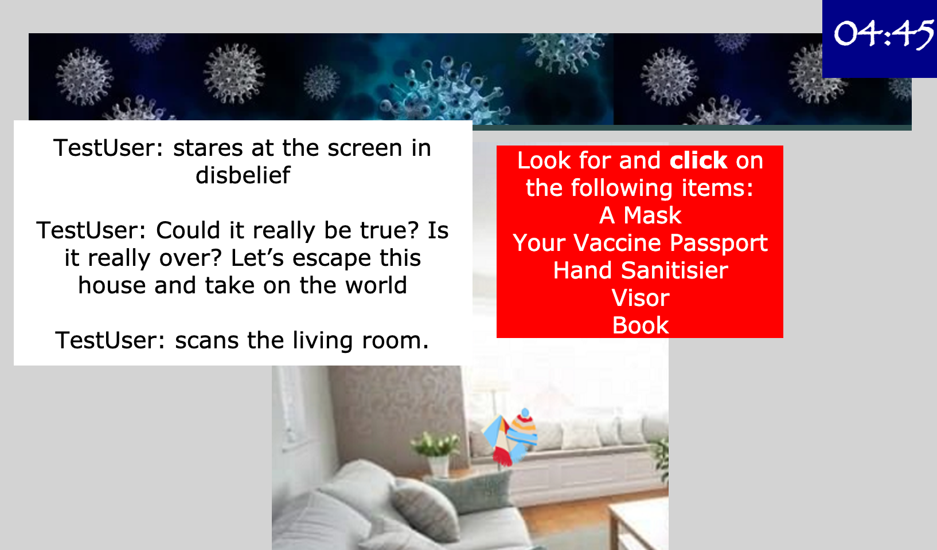
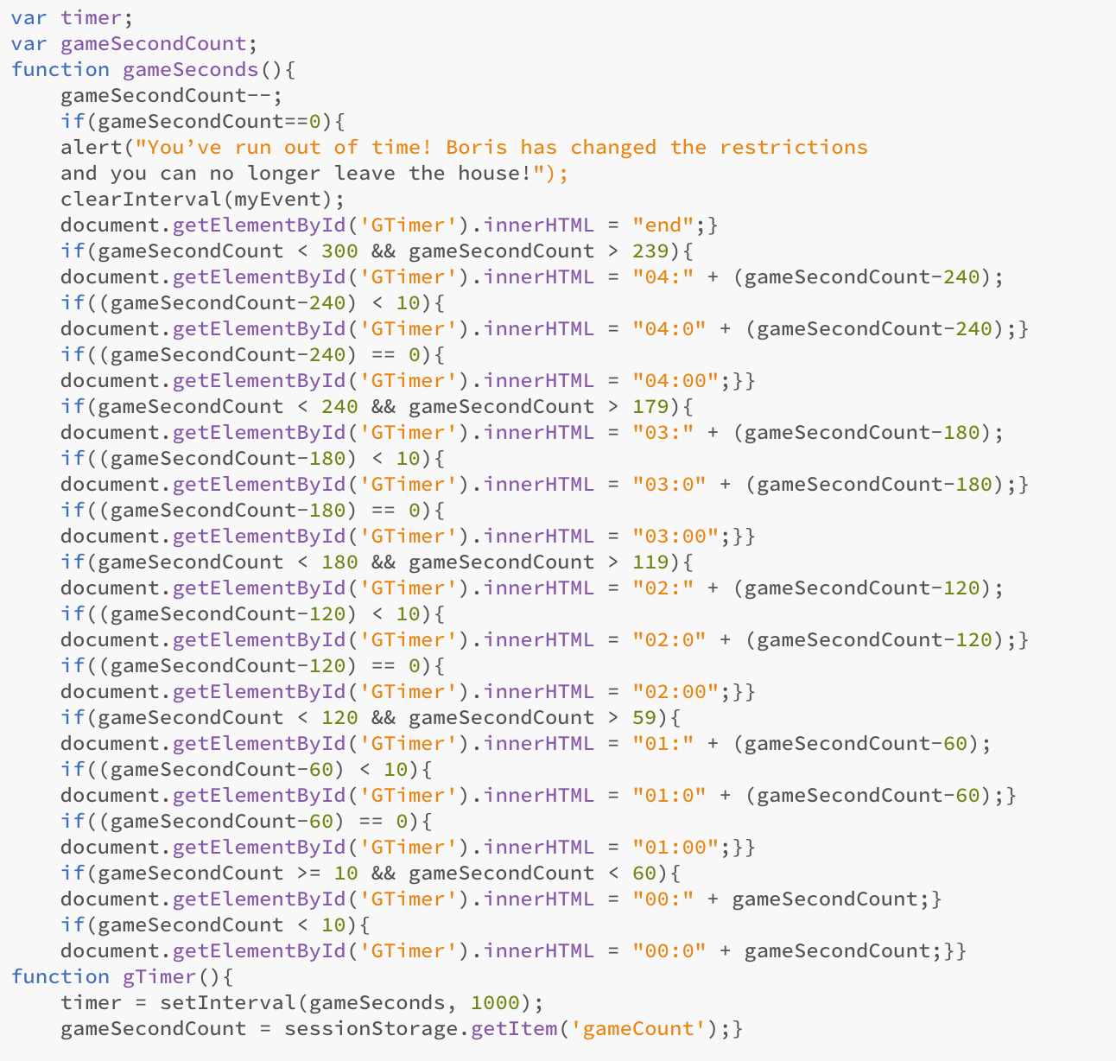
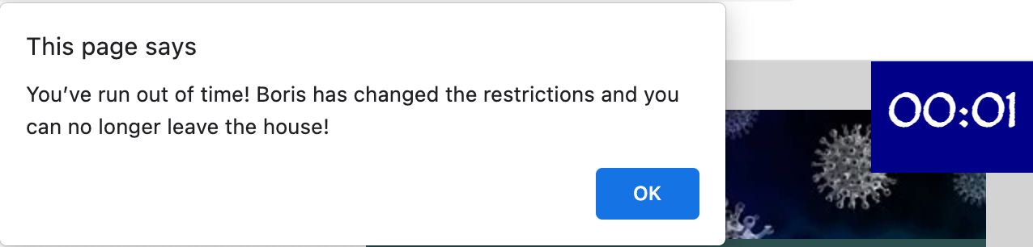
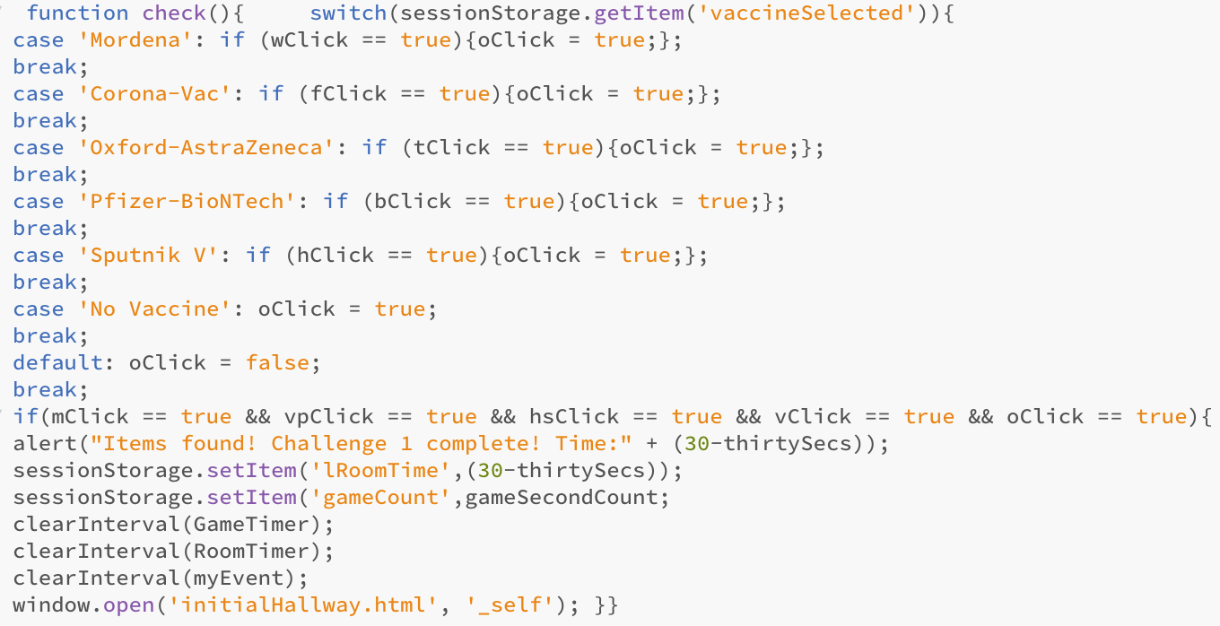

JavaScript Timed Events
Game Timer (5 Mins)
Game Timer Code
If no time left
Total 5 Minute Timer
Individual Room Timer
Changing Text According to Timer
Example of Timer Running Out
Display of time
Individual Room Timer Code
Place in session storage to pass to next page
Use case Vaccine click check
Individual Room Timer
Once all items found alert displayed and next page displayed
This example shows the time it took to complete the find items challenge

Slide 7
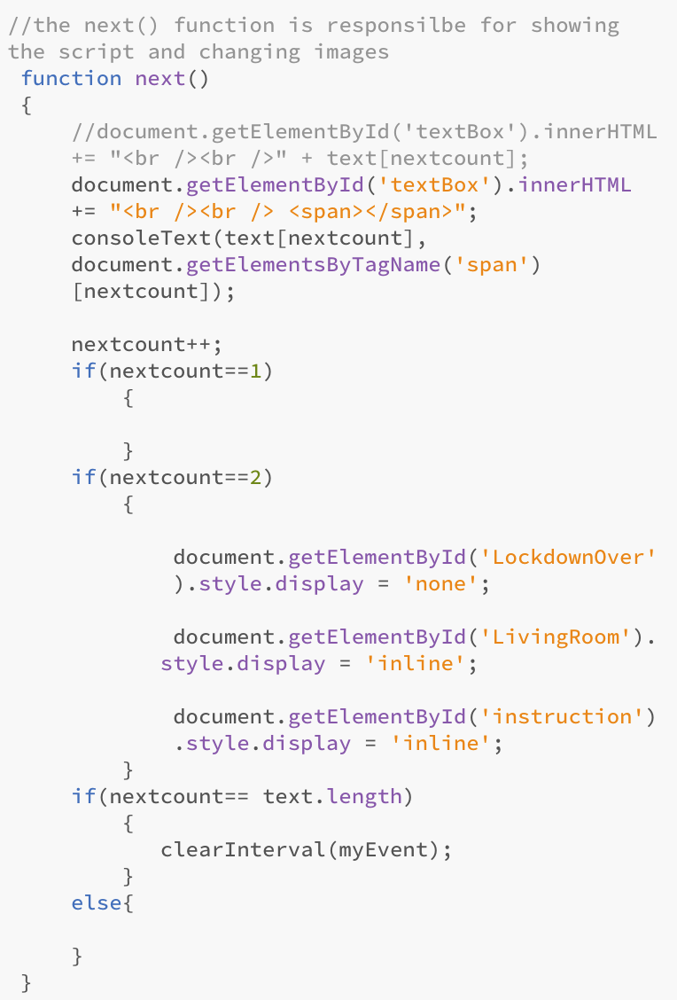
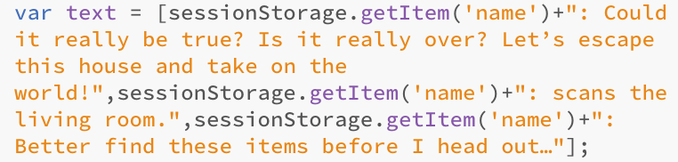
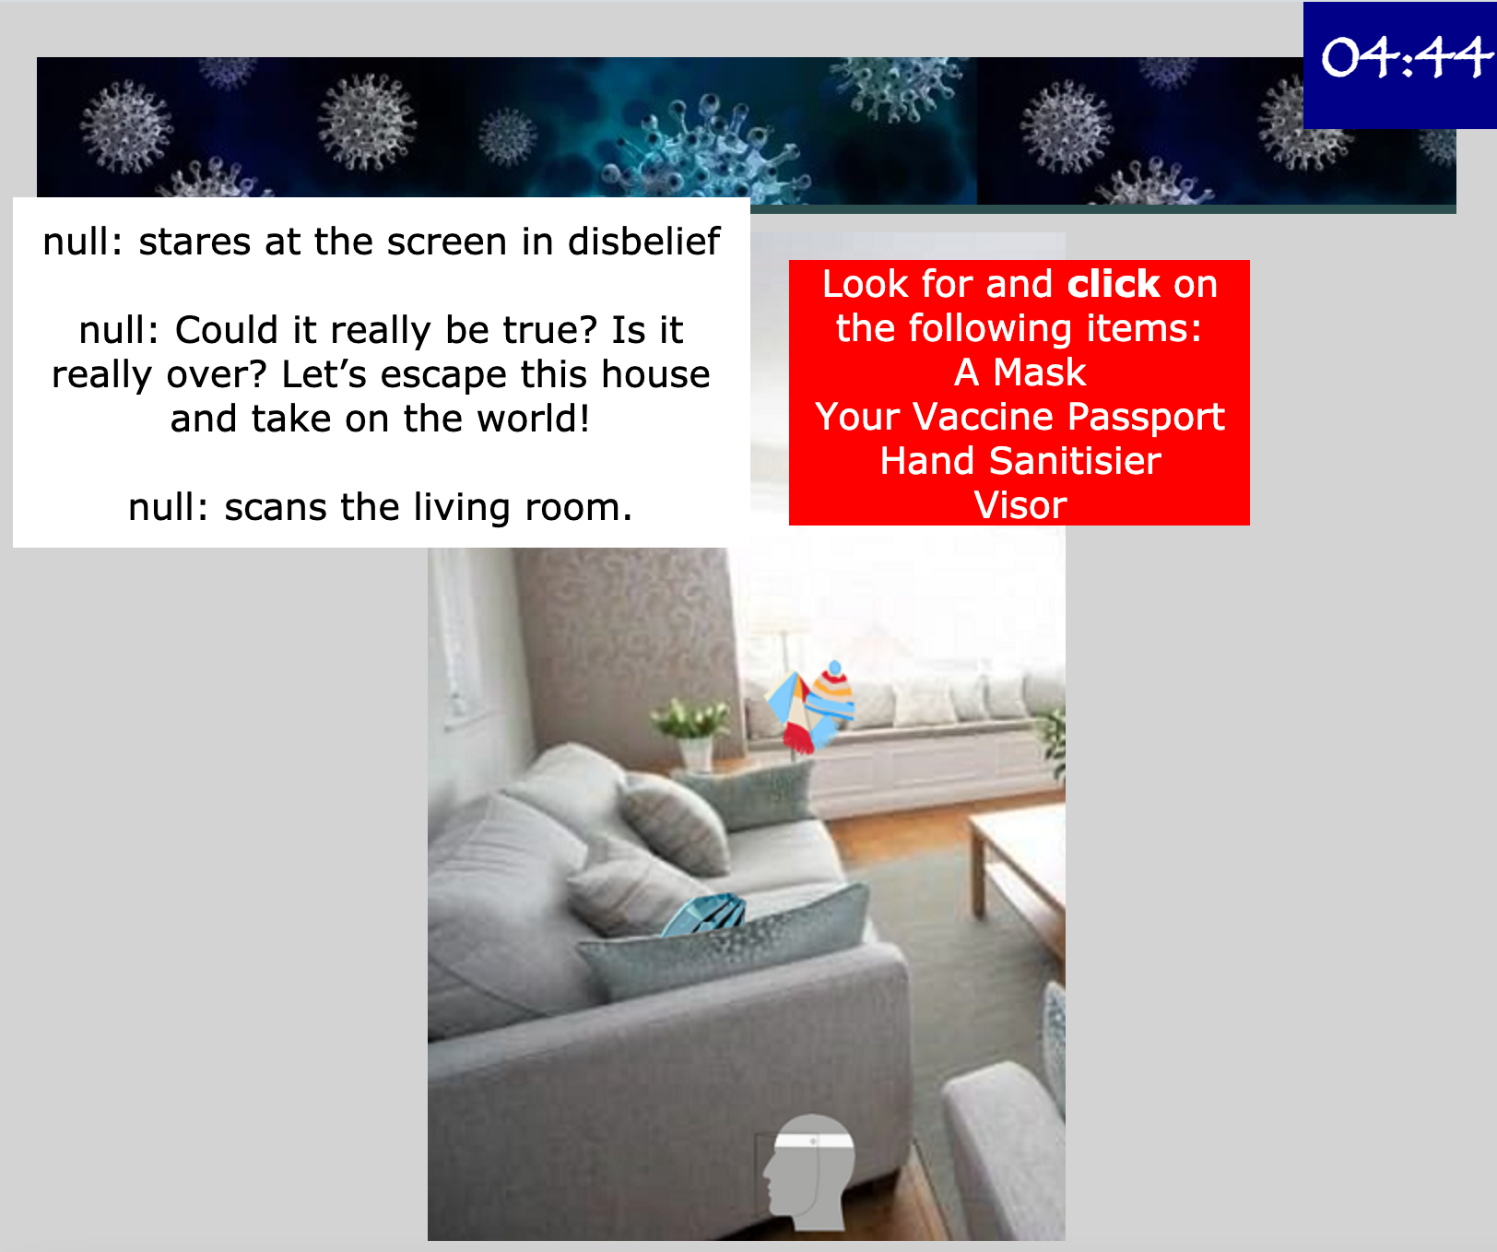
JavaScript Timed Events
Here we have inserted a snippet of code from the find items page to show how we change the text alongside the timer. This is achieved by placing our text into an array and then displaying it when the timer reaches a certain amount, we have used this method in multiple ways throughout our entire escape room.
For example, we also use this code to change the image/ page the user is at according the the timer
Array of the text that we want to be displayed including the name that was stored in session storage
Changing display

Slide 8
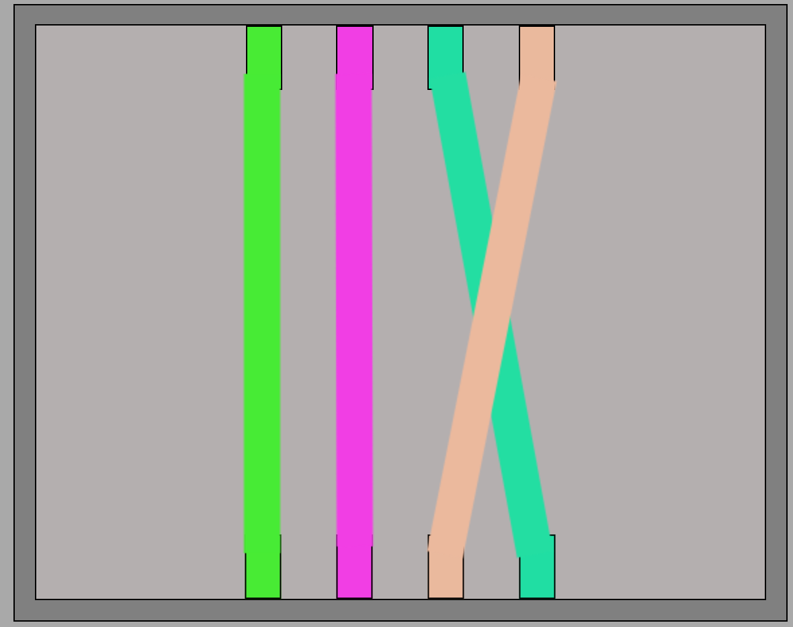
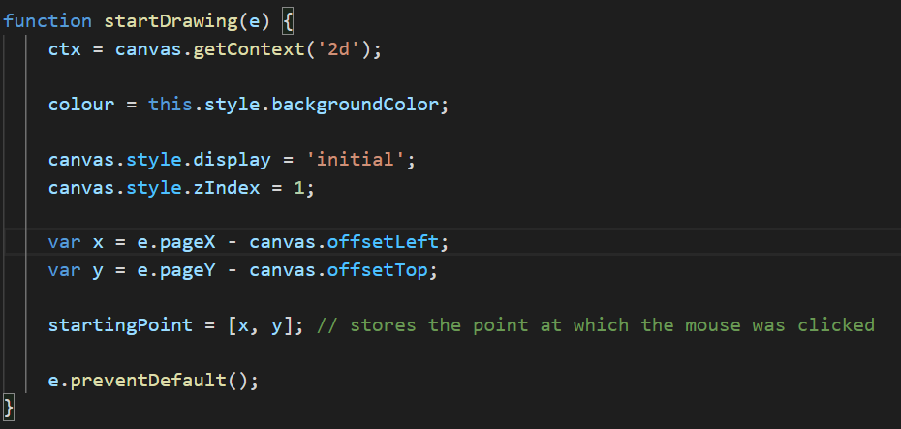
Escape Room Elements
Fuse Box
The fuse box game was created by using the HTML element ‘canvas’ to draw on the web page. The colours of the wires are randomly generated and are checked if they are similar to the other wire colours by checking how close the RGB values are. The position of the start and end connectors are also random, so the corresponding connectors are different for each playthrough. All the code to create the fuse box game could not fit onto this slide so the function to begin the drawing is shown below but if you wish to see the code in its entirety just go to fuseboxScript.js.
The function which starts the drawing of the wire:

Slide 9
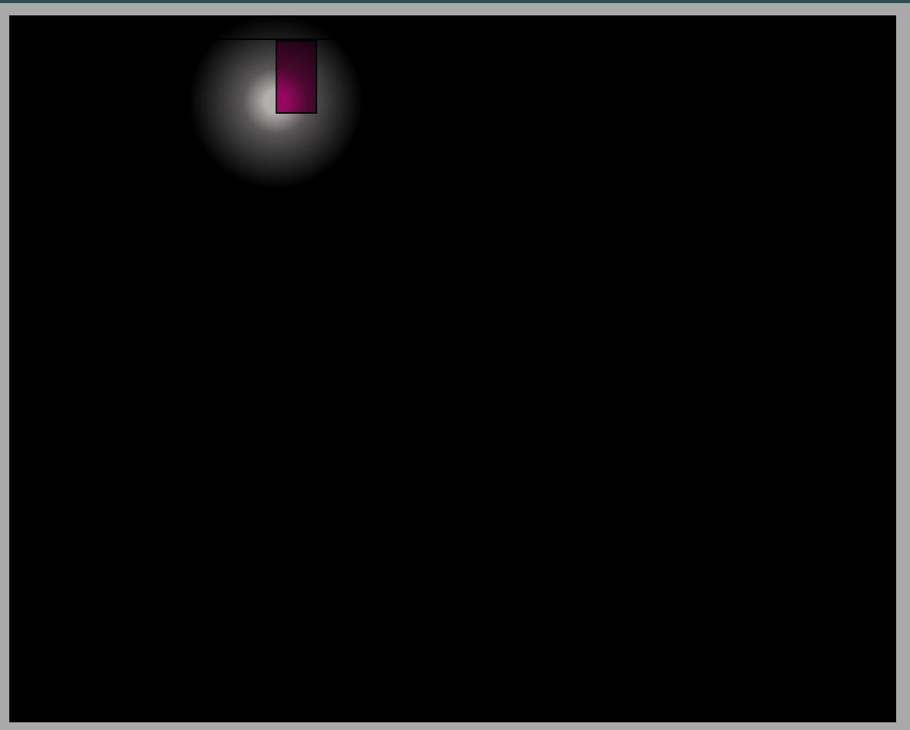

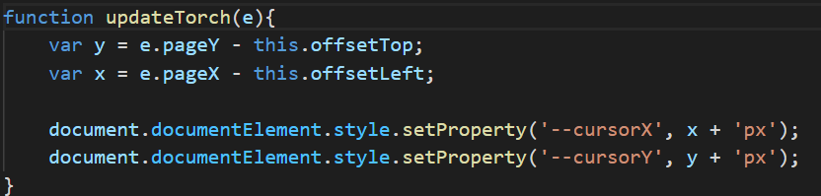
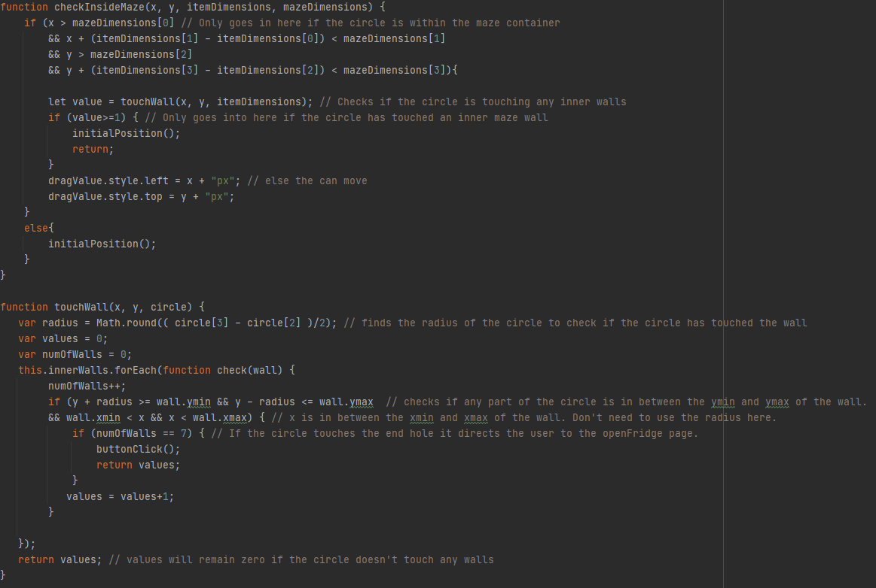
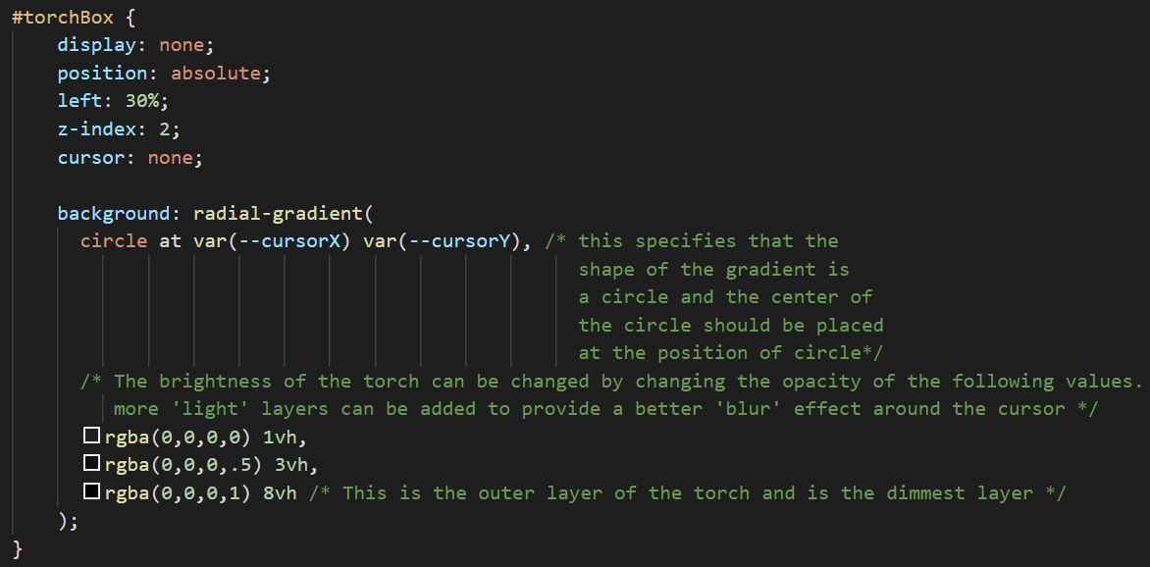
Torch Effect
Fridge Maze
The torch effect has been implemented using custom CSS properties to store the position of the cursor in a way in which a CSS file can access them. The radial-gradient function within CSS has been used in conjunction within the background property to create this effect.
The maze game has been implemented using a draggable item with restrictive outer maze borders and restrictive inner maze walls. The draggable item returns to the initial position if it touches any restrictive boundary.
JavaScript Code:
JavaScript Code:
CSS Code:

Slide 10
Statistics Generated
Here we have inserted a screenshot of our breakdown Statistics. This is the page that the user is shown once they finish the escape room. The breakdown displays all the stored time taken from each room individually
living room (find items challenge)
kitchen (fridge maze challenge)
basement (torch, fuse box and coat code)
colour pad (hex code challenge)
The breakdown statistics were derived by firstly reading the time taken in each room (once challenge room opens until challenge room closes) and then storing it as session storage so it can be passed and called again, then we displayed this time in the time taken on the table.

Slide 11
Statistics Generated
The leaderboard displays a rank of the top 4 players that completed the escape room the quickest along side their name and time taken.
If the user did not place in the top 4 then their time taken total will not be shown on the leaderboard
We feel like the leaderboard is very important as it makes the game more competitive
The leaderboard statistics are derived by using a timer. The 5-minute timer begins to count down as soon as the escape room starts, the timer is displayed in the top right corner of all pages. The timer then counts down from 5 minutes, if the user does not finish the game after 5 minute the user has lost. However, if the user does finish the game in under 5 minutes the leaderboard will be displayed. The overall time left is passed through the pages using local storage. We then calculate the time taken out of the 5 minutes using the time left and display it in the table.

Slide 12
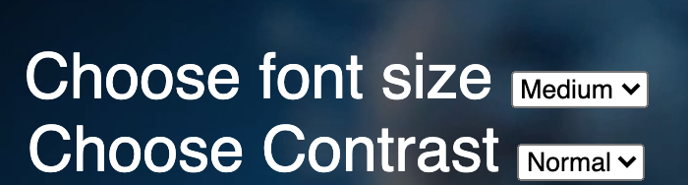
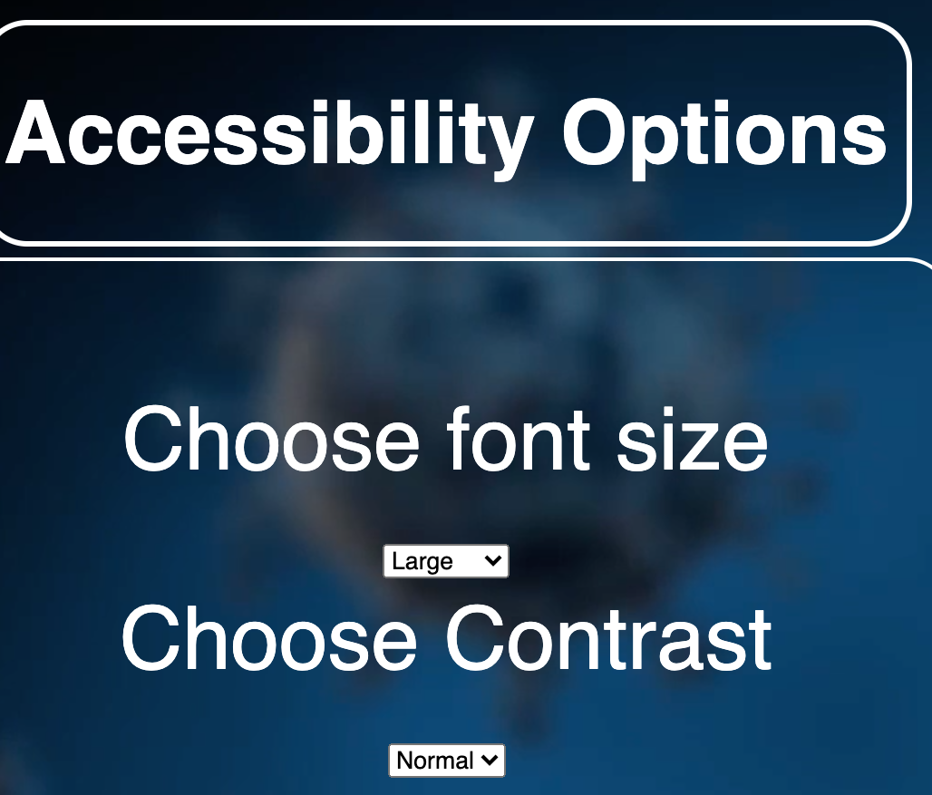
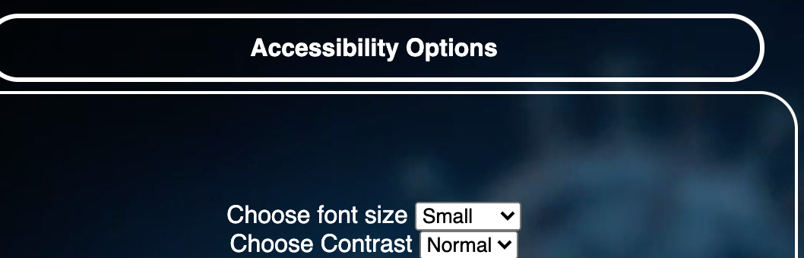

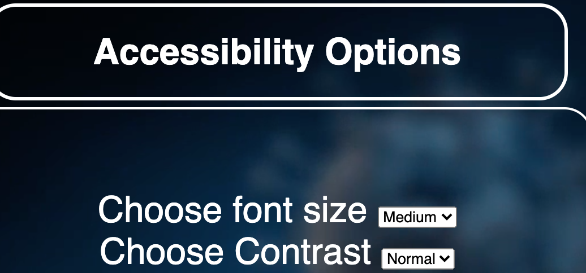
Accessibility Features
Contrast –allowing user to change contrast means that they can choose a colour scheme that causes less strain on their eyes
Font size- increasing the font size helps to avoid straining your eyes from squinting and for those with compromised vision, this can make reading much easier
Colour Blind Pad - creating a colour blind button on the colour pad means that the user will not be at a disadvantage as the name of the colour linked to the hex code will be displayed instead of the colour
The user can accessibility options from the start screen :
1. Font size
Small
Medium
Large
2. Contrast
Normal
High
We have also added vibrant colours, clear text, clear images and audio throughout our game to ensure that it is not strenuous on the and stimulating with sounds such as wires buzzing or typing when messages display, this ensures that the users has a good experience
Large Font
Small Font
Medium Font
The font size is then applied to all the pages of the escape room and can only be changed by the start screen

Slide 13
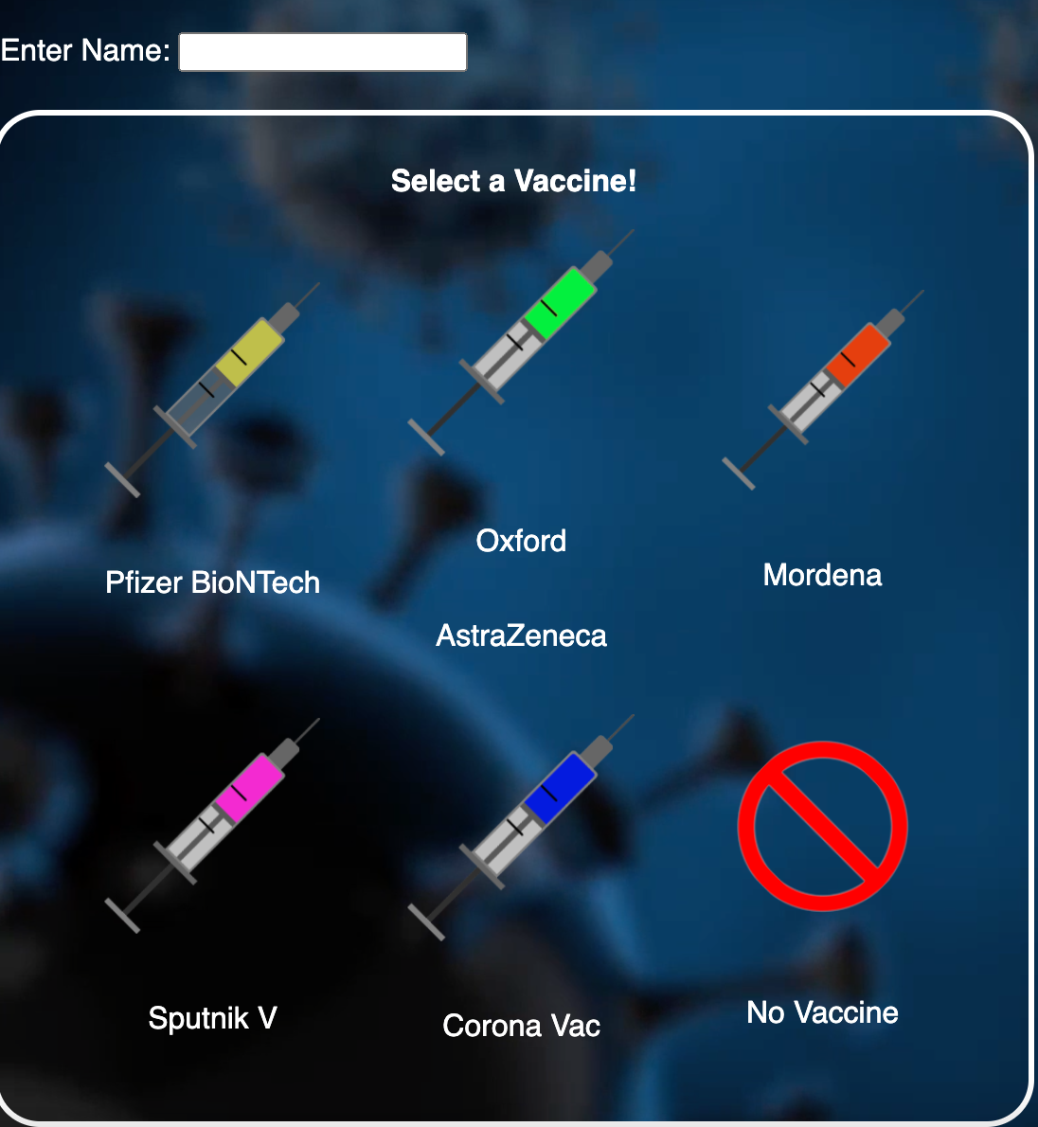
Accessibility Features
Colour Pad
Colour Blind Pad
High Contrast
Normal Contrast
To solve the issue of the colour pad challenge for those individuals who are colour blind we decided to add a button that will change the colours on the keypad display to words so the user can still solve the hex code the find the corresponding colour (word)
Contrast –allowing user to change contrast means that they can choose a colour scheme that causes less strain on their eyes, by making the colours darker it means the images and text are clearer as well as blocking out the video background behind images to make them more readable

Slide 14
Image Sources
All image sources can be found in the Image_Source_Group10.docx Microsoft Word Document
As we had too many images, videos and audio to references to fit into 2 slides
I hope you enjoyed our game just as much as we enjoyed making it
Thank you

